Slide 1
Honey Encryption: Security Beyond the Brute-Force Bound
Authors: Ari Juels, Thomas Ristenpart
Presented by: Shengye Wan
Some slides come from Thomas Ristenpart and Tuan Tran

Slide 2
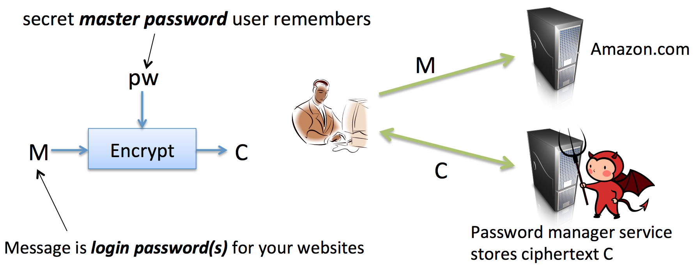
Problem– A Simple Case
Password Manager

Slide 3
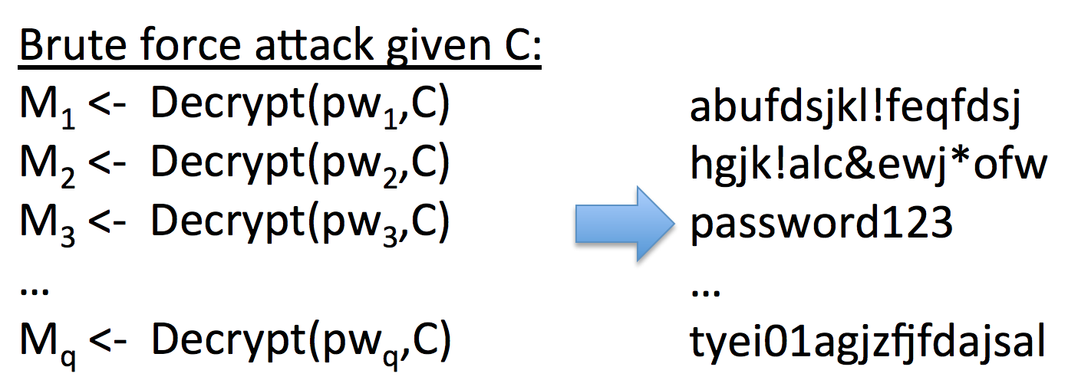
Problem– A Simple Case (Cont’d)
Cracking a password manager: Brute-force Attack

Slide 4
Problem– Other Cases
Information leakage caused by cracking encrypted database:
biggest hacking case in China’s Internet history, 6 million users
RSA secret keys: 100, 321849, 9883, 16
Cookies, other bearer tokens, other: authentication values
Non-authentication related? English language text

Slide 5
Threat Model
Password-Based Encryption (PBE)
low-entropy or weak secrets, most commonly user-chosen passwords
Message-Recover(MR) attack
--The attacker could use brute-force to guess the password
--Once the attacker decrypt one message successfully, he or she could get much more information.

Slide 6
Outline
Threat Model
Related Work
Motivation
Intro & Framework
Technical Details
Result
Conclusion
Discussion

Slide 7
Related Work– Hashing and Salt
In cryptography, a salt is random data that is used as an additional input to a one-way function that hashes a password or passphrase.
In a typical setting, the salt and the password are concatenated and processed with a cryptographic hash function, and the resulting output is stored with the salt in a database.
Salt only slows down attacks by constant factor.

Slide 8
Related Work– Recent Research
Kamouflage system
--It conceals a true password vault encrypted under a true master password among N bogus vaults encrypted under bogus master passwords.
Kamouflage requires O(N) storage.
Comparison
1) With a suitable DTE, HE offers the possibility of realizing similar functionality and security with O(1) storage.
2) HE doesn’t need to prepare plausible decoys.

Slide 9
Motivation– Decoys
Decoys, fake objects that look real.
Honeypots, fake computer systems intended to attract and study attacks.
Honeytokens, which are data objects whose use signals a compromise.
Honeywords, a system encompassing the use of passwords as honeytokens.
False documents, false network traffic, and many variants.

Slide 10
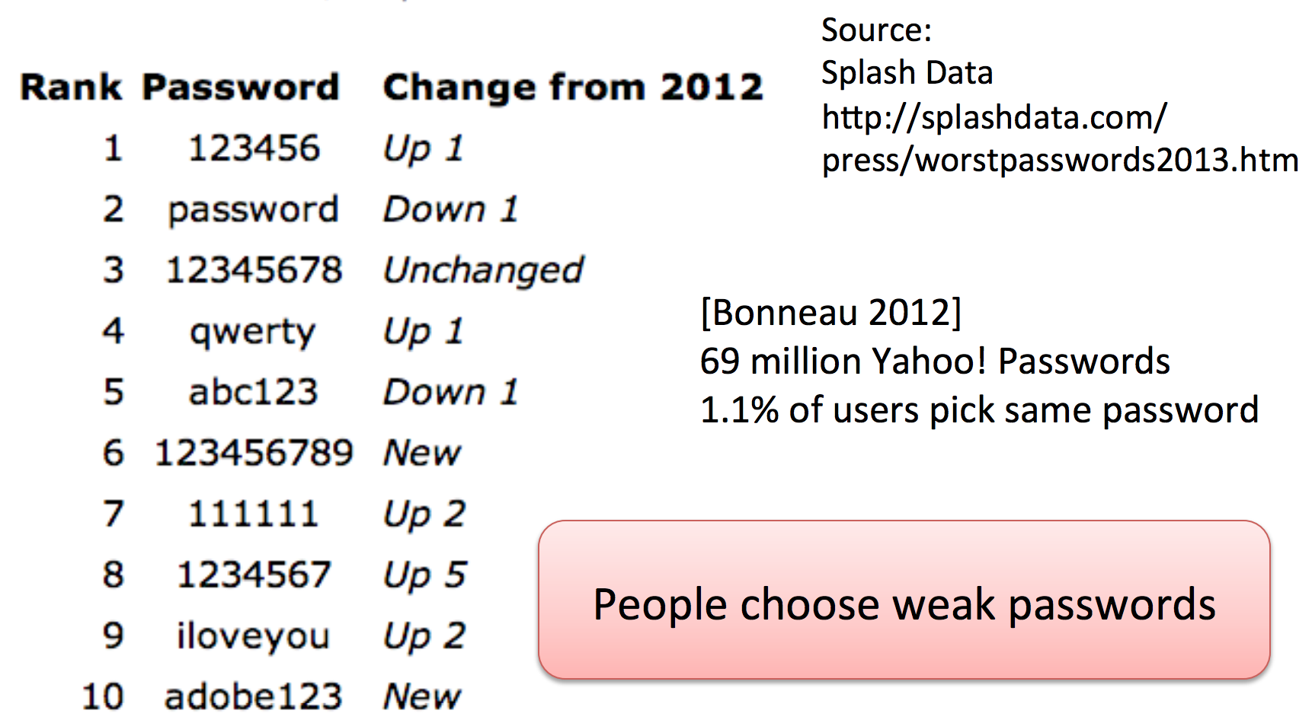
Motivation– Password Distribution

Slide 11
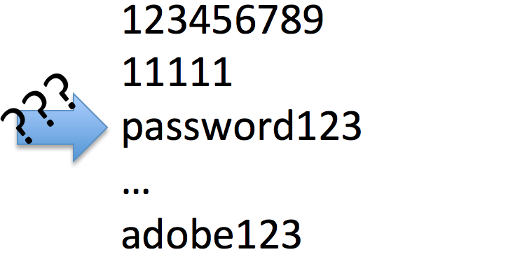
Motivation– Idea Case
Always return a password looks like the true password

Slide 12
Introduction
Honey Encryption(HE)
Providing MR security
Providing semantic security (when keys are sufficiently unpredictable and adversaries are computationally bounded)
--For any probabilistic, polynomial-time algorithm (PPTA):
Information determined by ciphertext of m + m’s length
= Information determined only by m’s length
Notes:
(taken from any distribution of messages)

Slide 13
Introduction (Cont’d)
Same API as password-based encryption scheme
HE uses special encodings to ensure that decrypting ciphertext with wrong key yields fresh sample from designer’s estimate of message distribution.
compact ciphertexts (unlike explicitly stored decoys)
Good encoding:
Attacker provably can’t pick out right message

Slide 14
Framework
Encryption maps a key and message to a ciphertext.
Decryption recovers messages from ciphertexts.
With the wrong key, decryption will emit a plaintext that “looks” plausible.
Its cornerstone is distribution-transforming encoder (DTE).

Slide 15
Technical Details
Encrypting a message M involves a two-step procedure.
1)Applying DTE to M to obtain a seed S.
2)Encrypting the seed S using the key K, yielding an HE ciphertext C.
Conventional encryption scheme must have message space equal to the seed space.
All ciphertexts must decrypt under any key to a valid seed.

Slide 16
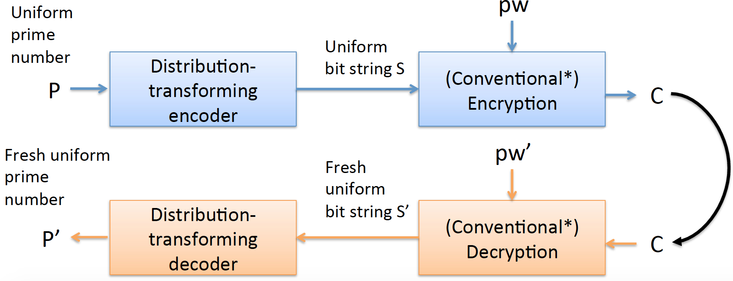
Technical Details– Working Flow
Using hash value to encrypt/decrypt a prime number

Slide 17
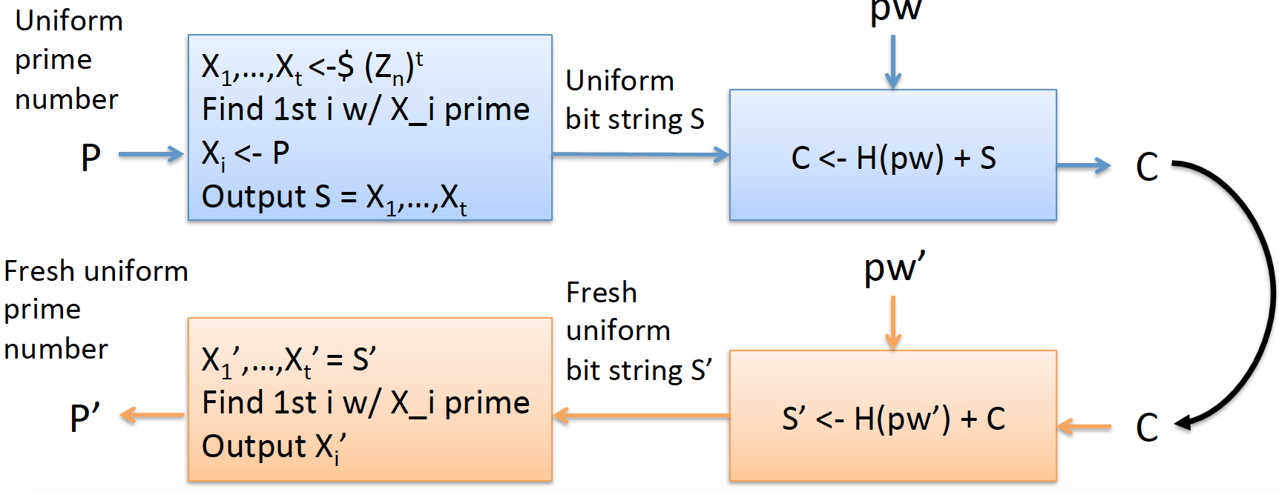
Working Flow (Cont’d)
Using hash value to encrypt/decrypt a prime number

Slide 18
Distribution-Transforming Encoder
A pair DTE = (encode, decode) of algorithms.
encode takes as input a message m ∈ M and outputs a value in a set S, the seed space.
decode takes as input a value s ∈ S and outputs a message m ∈ M.
An important attribution for DTE: Pr[decode(encode(M)) = M] = 1.

Slide 19
DTE (Cont’d)
A DTE encodes a priori knowledge of the message distribution p_{m}.
Applying the decode to uniformly sampled seed provides sampling close to that of a target distribution pm.
A secure DTE is such that attacker can not distinguish:
A pair (m, s) generated by selecting m from p_{m} and encoding it to obtain seed s.
A pair (m, s) generated by selecting a seed s uniformly at random and decoding it to obtain message M.

Slide 20
Inverse sampling DTE
Let F_{m} be the cumulative distribution function associated with a known message distribution p_{m}.
Inverse sampling picks a value according to p_{m} by selecting
S ∈ S = [0,1) and outputs M_{i} such that F_{m}(M_{i−1}) ≤ S < F_{m}(M_{i}).
For input message M_{i}:
Encodes by picking uniformly from the range [F_{m}(M_{i−1}), F_{m}(M_{i}))
Decodes by computing F_{m}⁻¹(S).

Slide 21
Result
By using HE, no attacker A can recover correct message with probability better than 1/2^{μ} .
Brute force bound: q/c2^{μ}.
q: attacking times
c: constant factor c, c=10,000
μ: min-entropy of password

Slide 22
Conclusion
Low-entropy secrets -> resources vulnerable.
HE yields plausible looking plaintexts under decryption with invalid keys.
HE never provides worse security than existing PBE schemes.
More generally, for human-generated messages (password vaults, e-mail, etc.), estimation of message distributions via DTEs is interesting as a natural language processing problem.

Slide 23
Discussion
HE security does not hold when the adversary has some side information about the target message.
Typos in passwords might confuse legitimate users in some settings.
When DTE is poor, HE security falls back to normal PBE security.

Slide 24
Quiz
For what scenario or application, HE could make a great contribution?
Why do we want to know the distribution of messages?
When do we call a DTE scheme correct?

Slide 25
Thank You!
Shengye Wan
Department of Computer Science
College of William and Mary

